Slide 1



CODESPHERE HACKATHON 2026
GCOE, JALGAON
TITLE PAGE
Problem Statement Title :- AI-Driven Hyper-Personalized Financial Intelligence&
Decision Support Platform
Theme :- FinTech
Team Name :- Team ArthSetu
Team Leader’s Name :- Sultane Ajinkya Jagannath
College Name - Government College of Engineering, Jalgaon

Slide 2

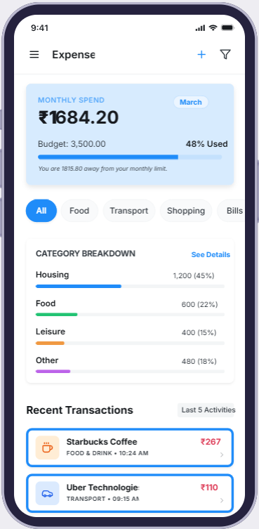
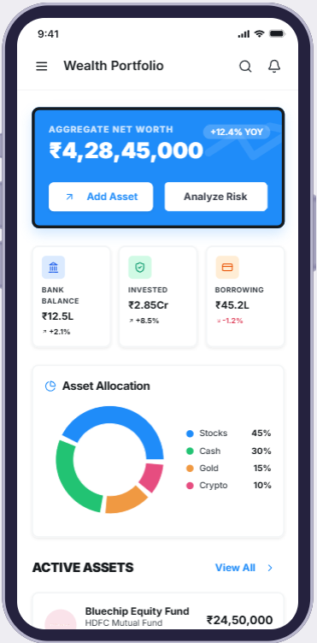
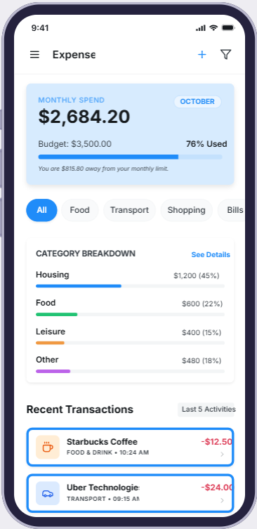
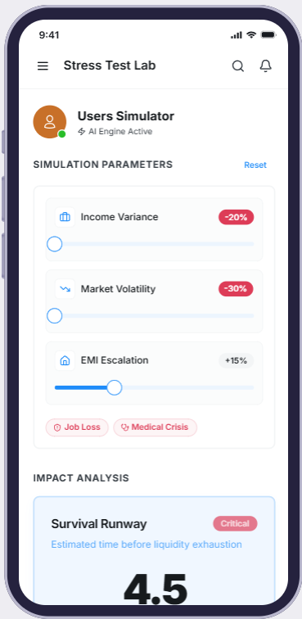
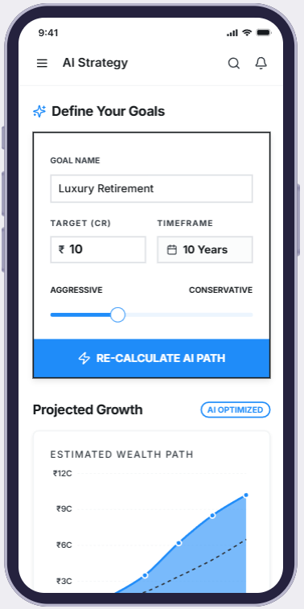
ArthSetu AI – Your Personal Financial Assistant
GCOE, JALGAON
Proposed Solution :-
1. Expense Tracker:- it is an intelligent financial monitoring system that:
Tracks Daily, Weekly, and Monthly Expenses.
Automatically detects transactions using SMS parsing .
Categorizes spending behavior
Generates real-time expense reports and analytics
2. Wealth & Visualization :-
A. Wealth Module provides a view of complete financial position by tracking Savings, Investments, Bank Balance.
B. Visualization: Generates dependency graphs and detects hidden risks and shows warnings and Risk factors.
HOW IT ADDRESSES THE PROBLEM :-
Our Solution Provides:
Unified Financial Dashboard
Real-time expense tracking
Behavioral learning system
Future cash flow prediction
AI-generated explainable recommendations
3. Risk Model :-Send a notification when the threshold is reached.
A mathematical system that predicts:
Overspending risk
Financial instability
Unusual transactions
4. Services We Provide :-
Anomaly Detection
Spending Velocity
Financial Risk Scroe
Overall Financial Health
Multi-Bank And Transaction Support

Slide 3
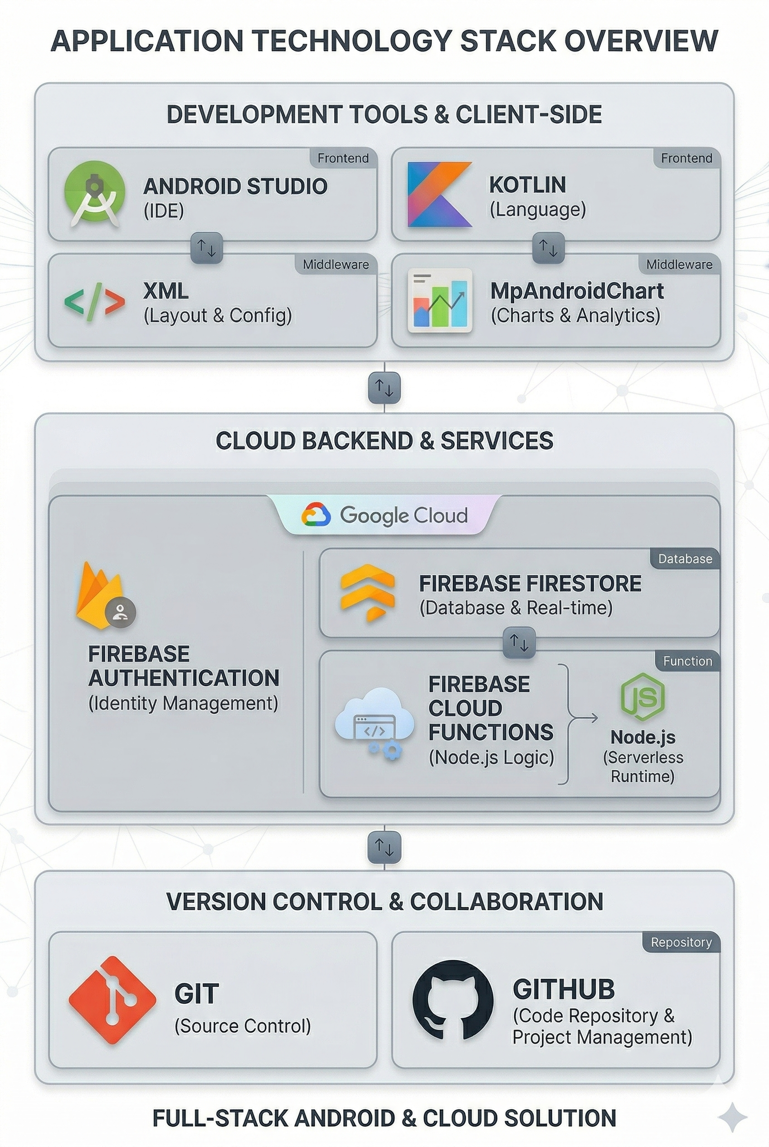
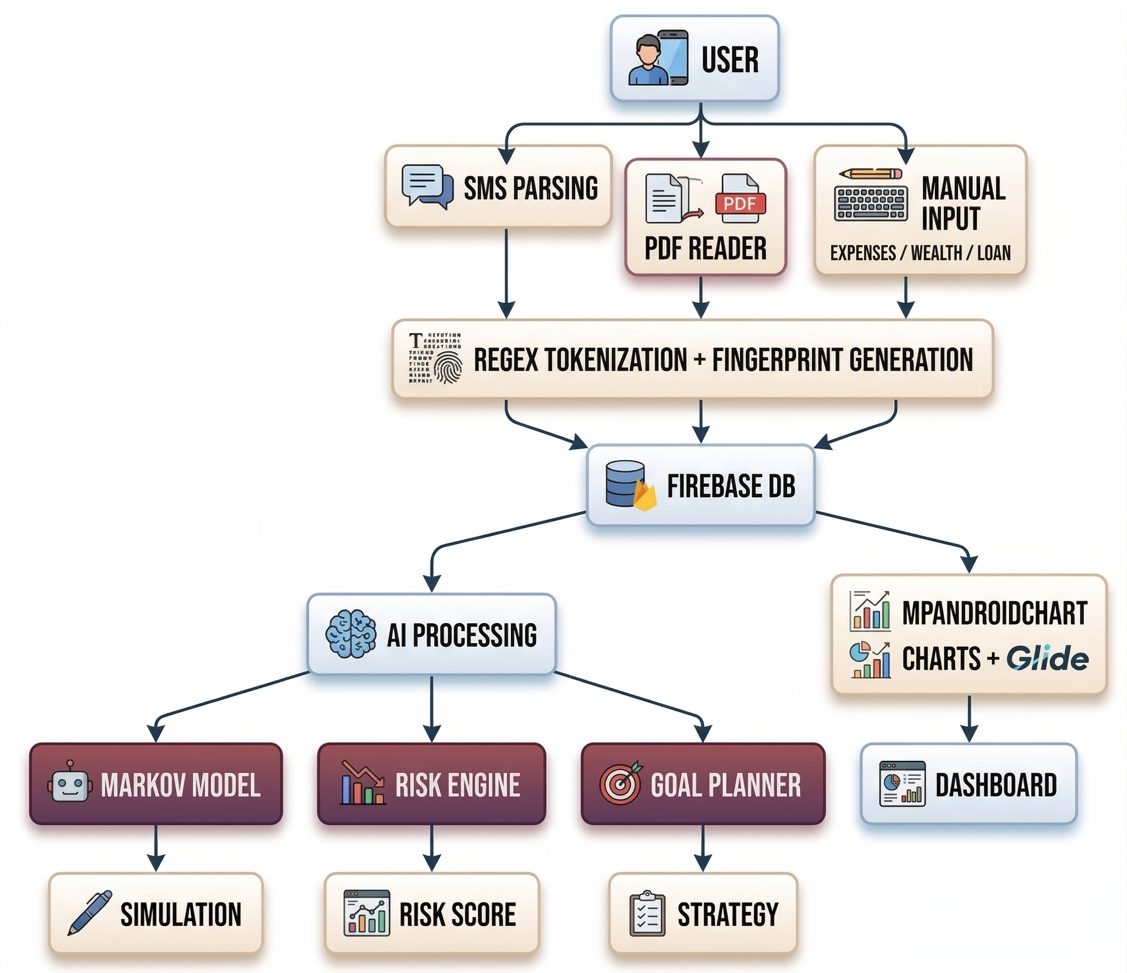

TECHNICAL APPROACH
GCOE, JALGAON

Slide 4
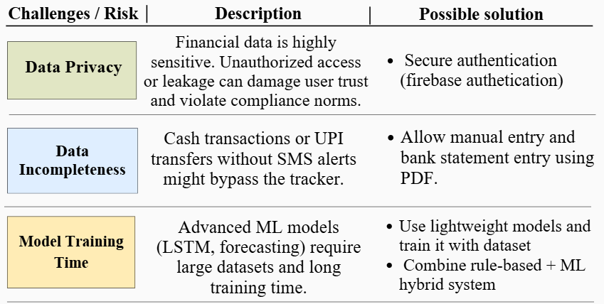
FEASIBILITY AND VIABILITY
GCOE, JALGAON
Feasibility Analysis
Uses proven Android SMS parsing capabilities
Built on scalable Firebase cloud infrastructure
Firebase cloud function and models suitable for real-time processing
Modular architecture enables rapid development
Designed as a deployable MVP within hackathon timeline

Slide 5
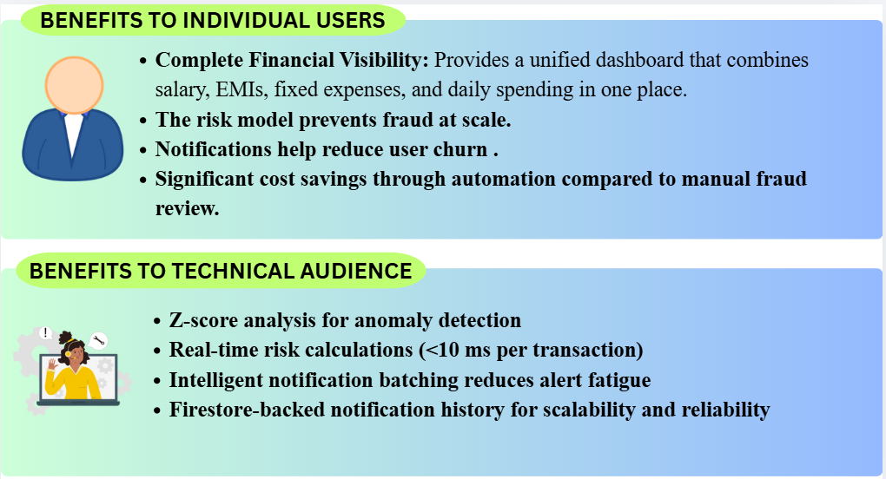
IMPACT AND BENEFITS
GCOE, JALGAON
IMPACT
Social Impact :-
Prevents debt traps
Improves financial discipline
Encourages goal-based savings
Economic Impact :-
Reduced income stability
Early financial stress detection
Better liquidity planning
Improved investment discipline

Slide 6
RESEARCH AND REFERENCES
GCOE, JALGAON
Research Inputs
Firebase official documentation
Android SMS Retriever documentation
Network Models in Economics and Finance
Technical References
Firebase Documentation — https://firebase.google.com
Android SMS APIs — developer.android.com
Personal finance behavioural research papers
Probabilistic Graphical Models :- Classic foundational work - Judea Pearl

